Slide 1




NYMAZ: Sounding Out
Author: Grace McNeill

Slide 2
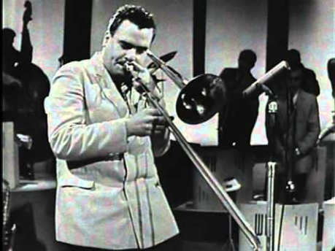
Have a listen…
Q1. What instruments can you hear?
Q2. Where do you think this music is from?
Q3. What type of music do you think this is?

Slide 3
Exploring Jazz
SOUNDING OUT resource

Slide 4
Jazz Music
We will be exploring the music of America! Looking in particular at Jazz!
Where does it come from?
What musical influences are there?
We will be looking at:
What instruments are used
Learning the Rhythms and Structure of Jazz music
Performing a piece with improvisation!

Slide 5
Key words/ Terms
Syncopation
Walking Bass
Improvisation
Instrumental Break
Head
Syncopation – when the off beat is accented.
Walking Bass - Bass line that moves up and down repeatedly throughout.
Improvisation - Musical phrases made up on the spot to fit the work, creating a solo.
Instrumental break - Section of music between the main phrases where instruments take solos.
Head – this is the section in the music which acts as the main riff, and the ensemble all know and play in unison.

Slide 6
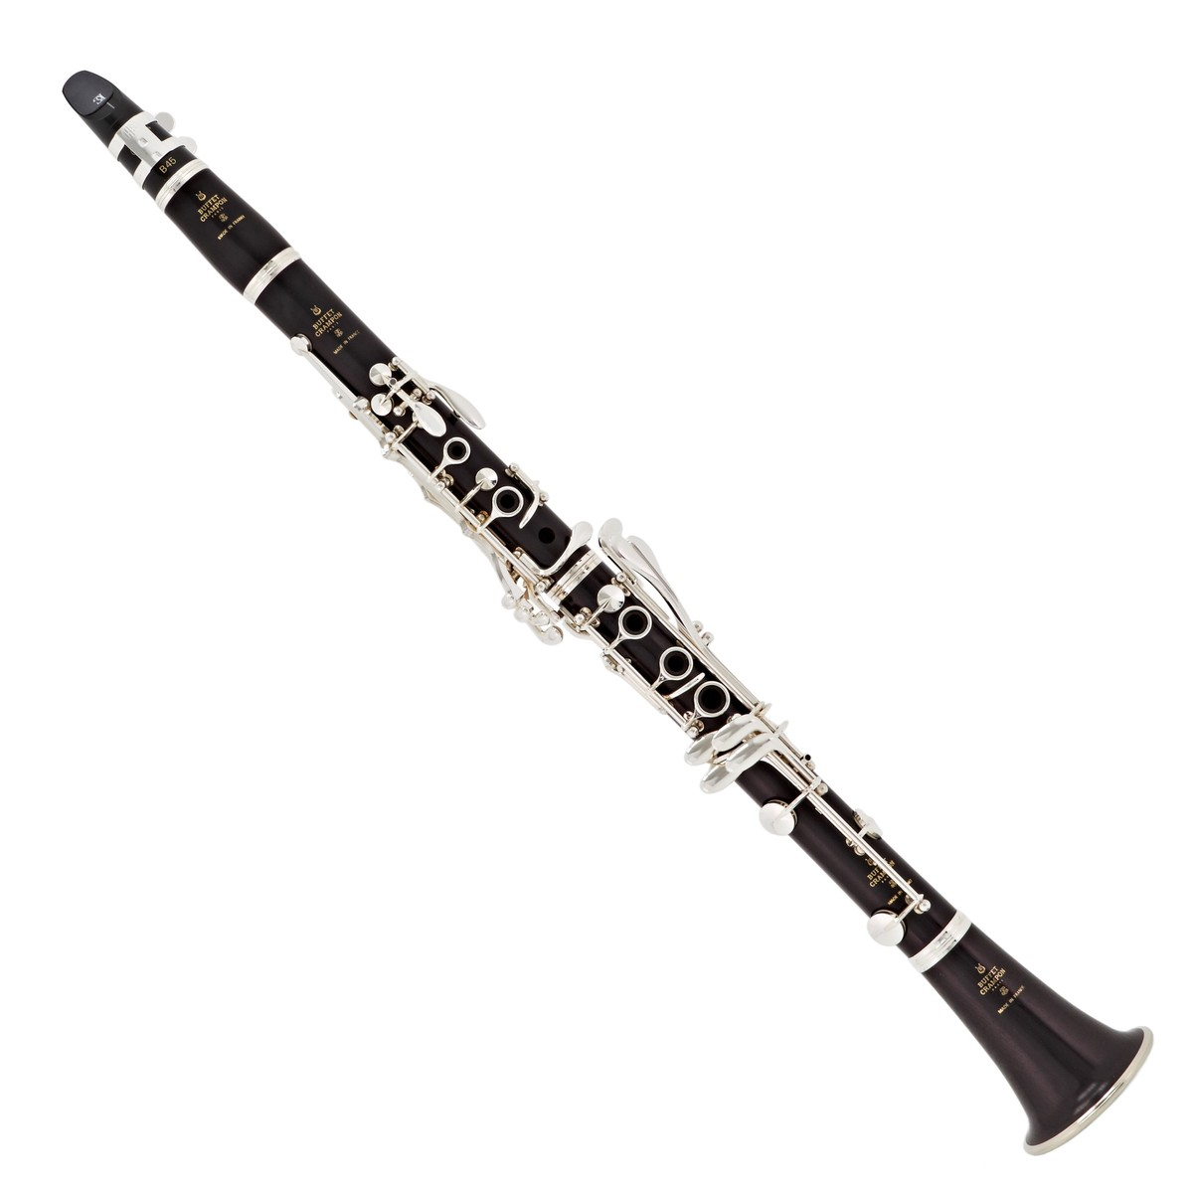
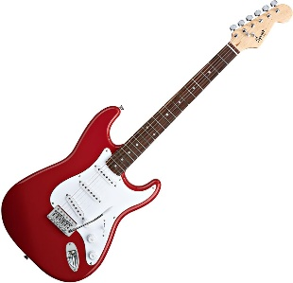
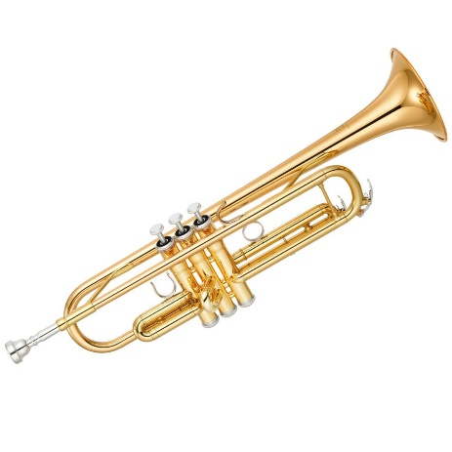
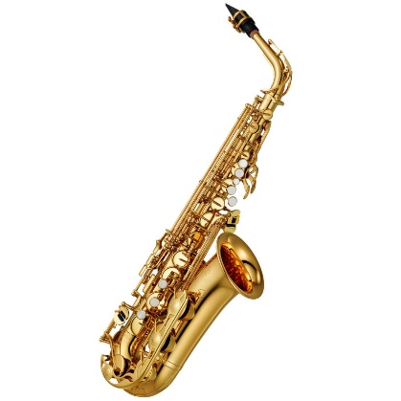
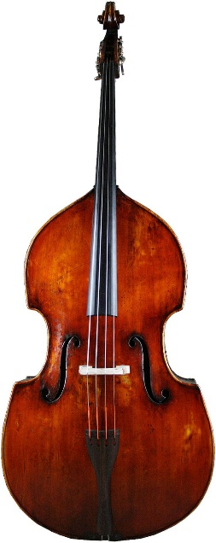
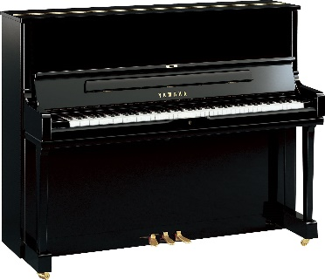
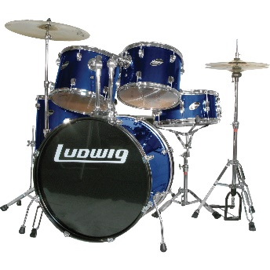
3. Clarinet
2. Electric Guitar
7. Trumpet
1.Saxophone
6. Double Bass
4.Piano
Can you guess their names?
5. Drum Kit
Notes:
6

Slide 7
Improvisation!
Keywords/terms:
Syncopation
Walking Bass
Improvisation
Instrumental Break
Head
Improvisation is a technique used to create interest, excitement and show off skill! We are going to try this activity:
Leader: Claps a rhythm such as
‘I – Like –Fish and Chips’
Group: clap it back
Every person to come up with their own rhythm and have it clapped back
The challenge is to keep it in time and flowing all the way around the group!

Slide 8
Developing Improvisation !
Using conducting we can change how we react to gestures musically!
We will improvise responses to different movements.
What do you think it means if I raise my hands high? Or low?
What about if I stomp?
Or even slide my feet?
Lets make some improvised musical responses to these conducting actions!

Slide 9
Recap!

Slide 10
3. Clarinet
2. Electric Guitar
7. Trumpet
1.Saxophone
6. Double Bass
4.Piano
Can you guess their names?
5. Drum Kit
Notes:
10

