Slide 1




NYMAZ: Sounding Out
Author: Grace McNeill

Slide 2
Listening activity
Listen to the Track 10, Wood Choppers Ball: https://open.spotify.com/playlist/7q7FESxJhphIpzrcyJFzUs
Can you answer the following questions?
Q1.What instrument starts this piece off?
Q2. What can you hear in the bass?
Q3. How did this style of music develop in America?
Q4. What is the instrument called that plays the Walking Bass Line?
Q5. What instrument plays the first solo?
Q6. What kind of solo does he play?
Q7. When the performance returns to the original section what is this called?
Q8. How would you describe the rhythm of the main melody?

Slide 3
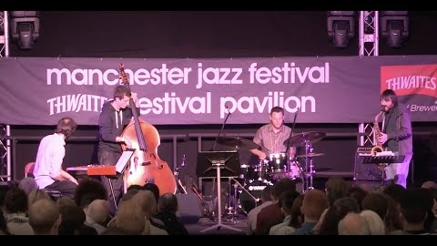
Have a listen…
Listen from 33 secs to 1min 24 secs
Q1. What style of Jazz do you think this is?
Q2. What are the similarities between this and what we heard last week?
Q3. Why do you think it is so different? Would you still class it as Jazz? Why?

Slide 4
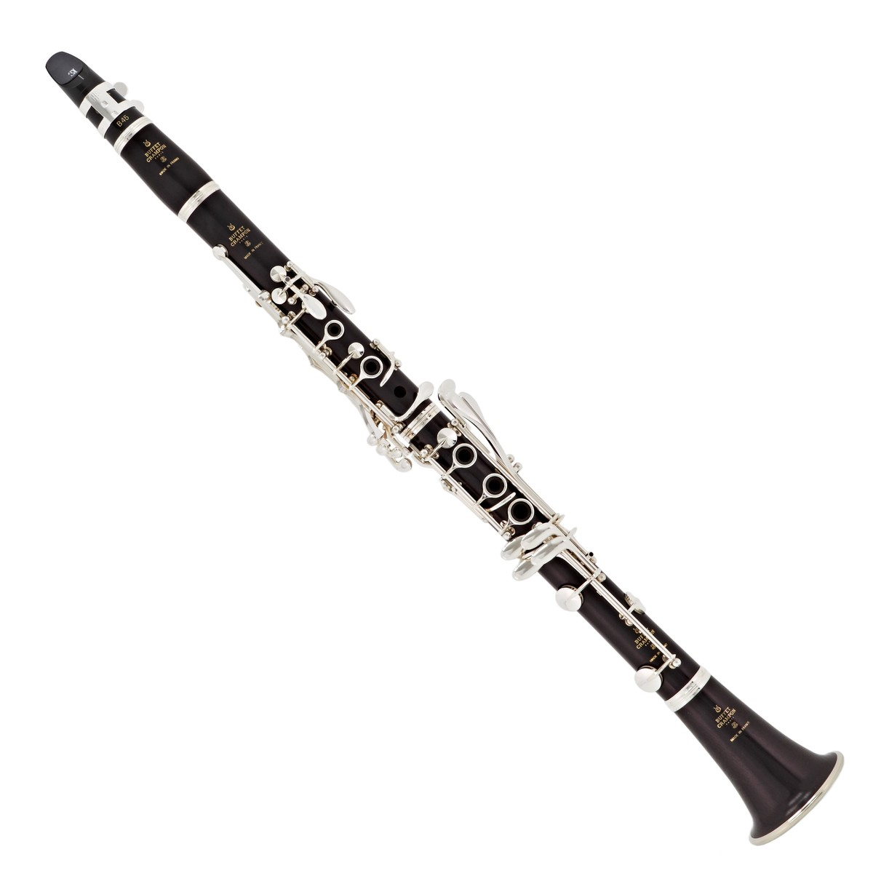
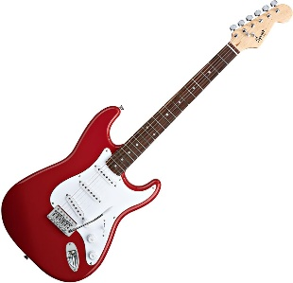
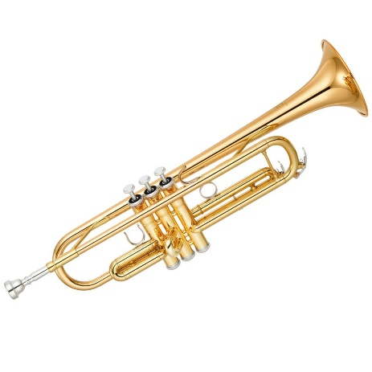
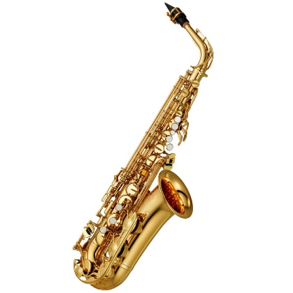
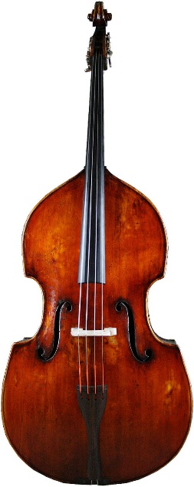
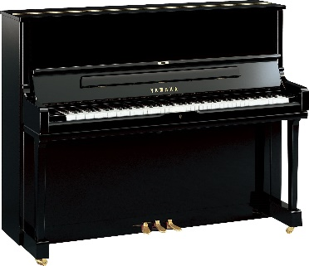
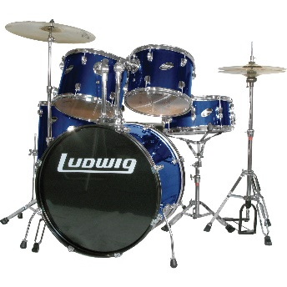
3. Clarinet
2. Electric Guitar
7. Trumpet
1.Saxophone
6. Double Bass
4.Piano
Can you Remember their names?
5. Drum Kit
Notes:
4

Slide 5
Can you remember?
Syncopation – When the off beat is accented.
Walking Bass – Bass line that moves up and down repeatedly throughout.
Improvisation – Musical phrases made up on the spot to fit the work, creating a solo.
Instrumental break – Section of music between the main phrases where instruments take solos.
Head – This is the section in the music which acts as the main riff, and the ensemble all know and play in unison.

Slide 6
Jazz Performance
Keywords/terms:
Syncopation
Walking Bass
Improvisation
Instrumental Break
Head
E – G – E – E – E – G
Using the notes above, we will create a ‘Head’ section to perform to the rhythm:
‘I – Like Fast – Jazz – Mu-Sic’
Try develop a walking bass line using the notes:
II: E – G – B – C – D - C – B – G :II
I can perform and keep to the beat.
I can perform a melodic syncopated riff
I can perform a walking bass line on top of the riff and Head rhythm
Assess yourself!

Slide 7
Structure!

Slide 8
Jazz Structure
Head Riff
Melodic Riff and Bass Line
Instrumental Break
Head Riff
Improvisation Solos
Head Riff
Develop and refine your groups structure for performance!

Slide 9
Perform and record!

Slide 10
Assessment
As an individual:
Write down which part you performed.
Could you remember all the sections and rhythms?
Did you stay in time?
Did you take on a solo?
Did you play the melodic riffs accurately and with confidence?
What did you do really well?
What could you improve personally in your performance?
As a group – think about what went really well in the performance, and think up two areas which could be improved next time.

